Slide 1
Neural Networks
Vamsikrishna Gopikrishna

Slide 2
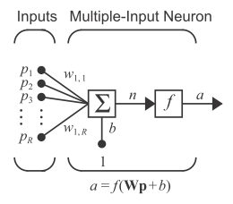
Neuron Architecture

Slide 3
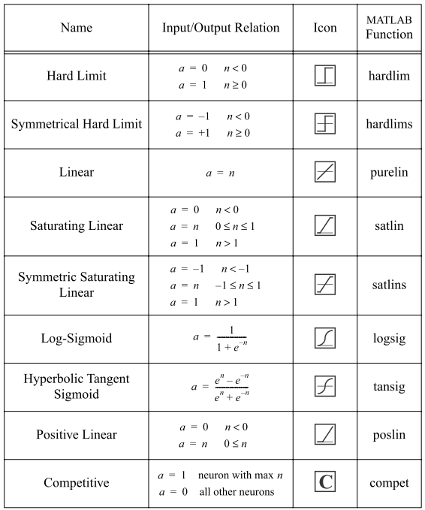
Transfer Function

Slide 4
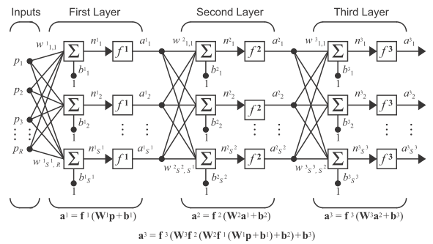
Multi-Layer Network

Slide 5
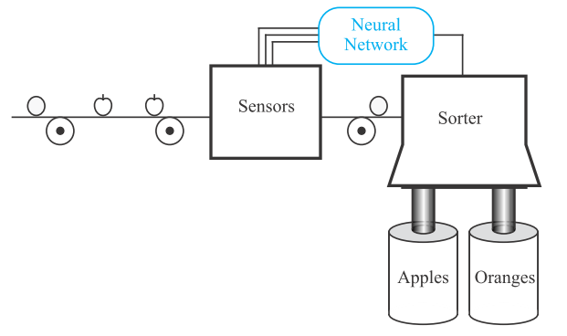
Sample Problem

Slide 6



Sample Problem

Slide 7

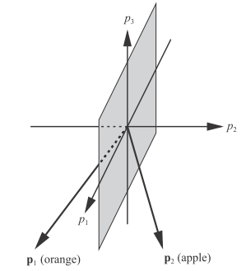
Sample Problem

